Slide 1

Topics in Deep Learning
A Visual Introduction

Slide 2
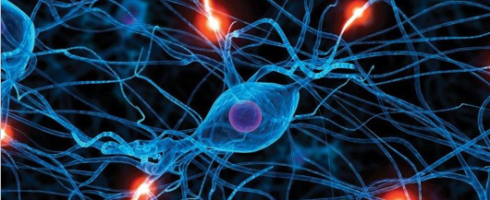
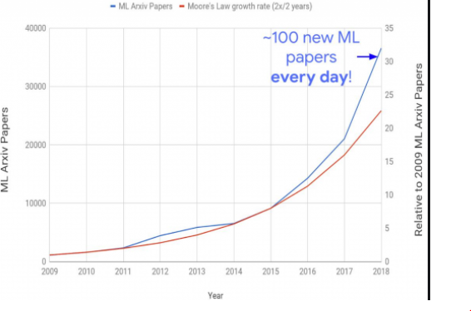
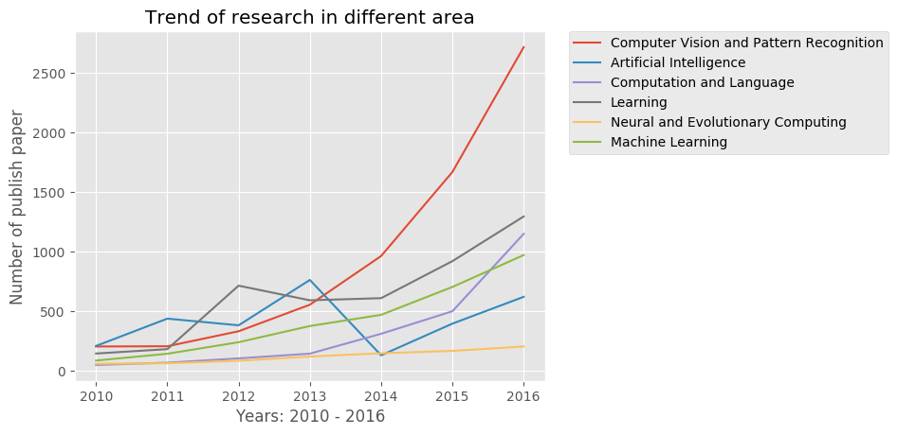
The Hottest Topic in the Computer Fraternity

Slide 3
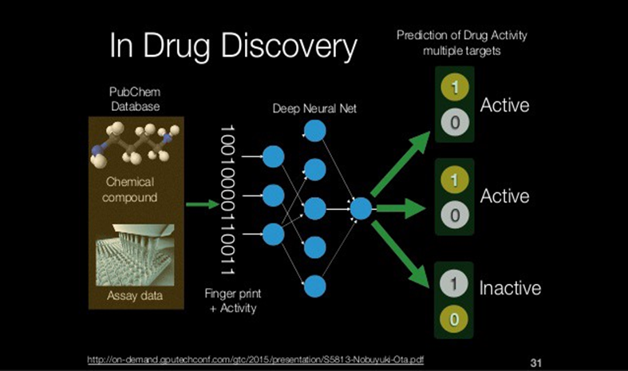
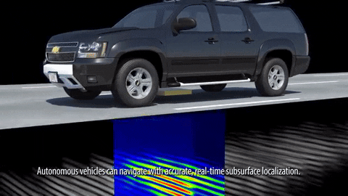
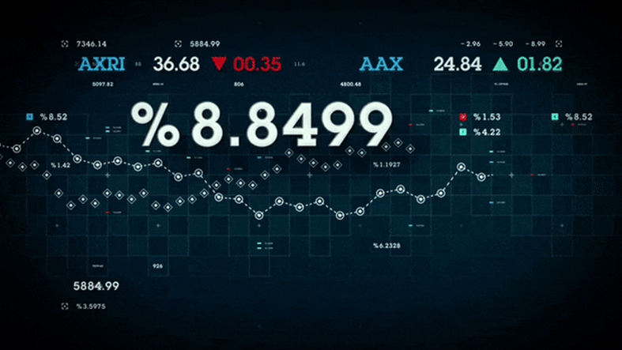
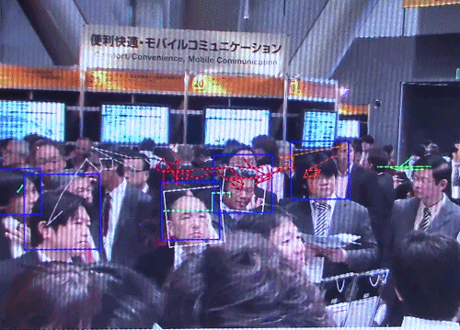

TDL Applications
Type Course Material Here

Slide 4
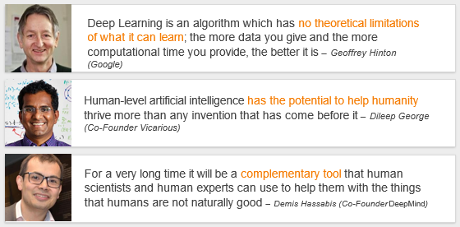
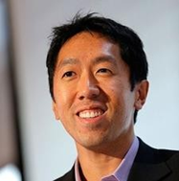

Hype or Reality

Slide 5

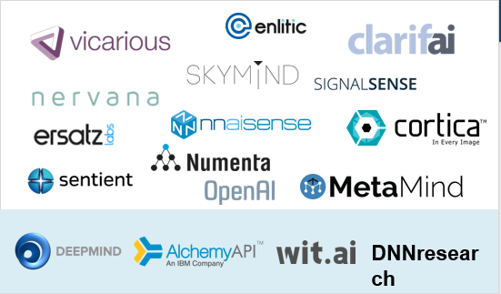
Players in Deep Learning

Slide 6
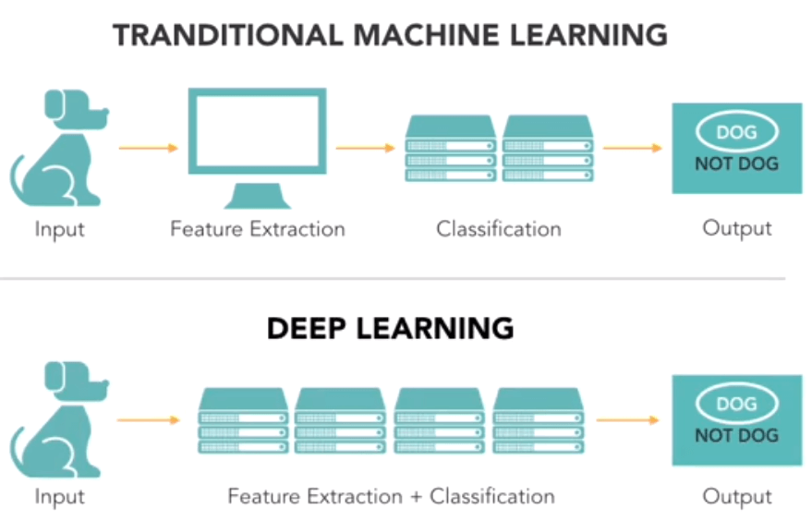
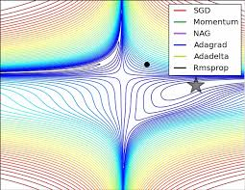
Broad coverage Unit 1

Slide 7
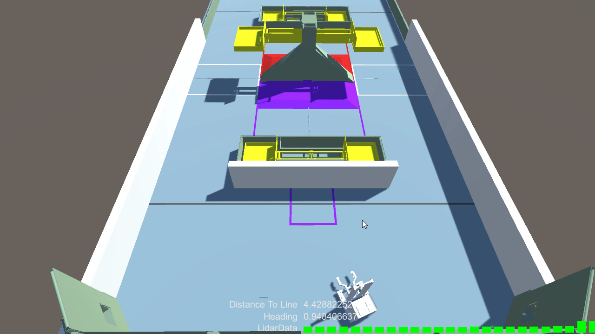
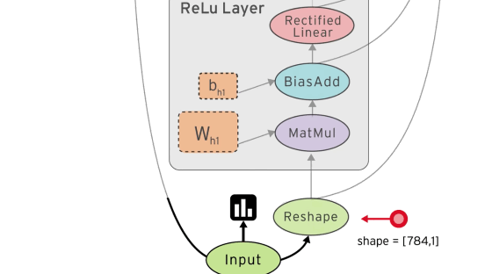
Broad Coverage – Unit 1
Reinforcement Learning
Keras and TensorFlow

Slide 8
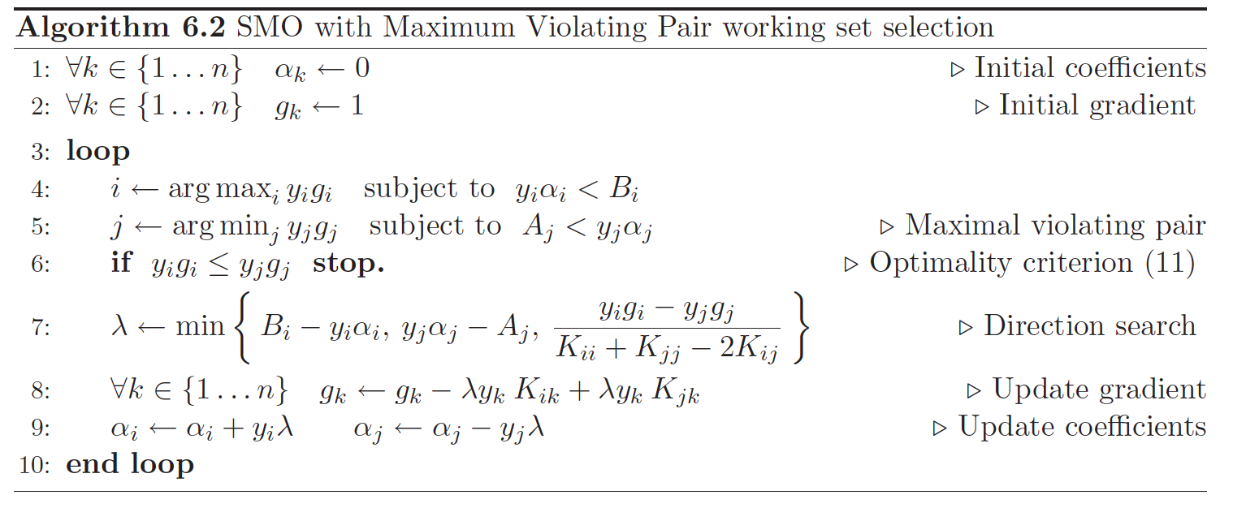
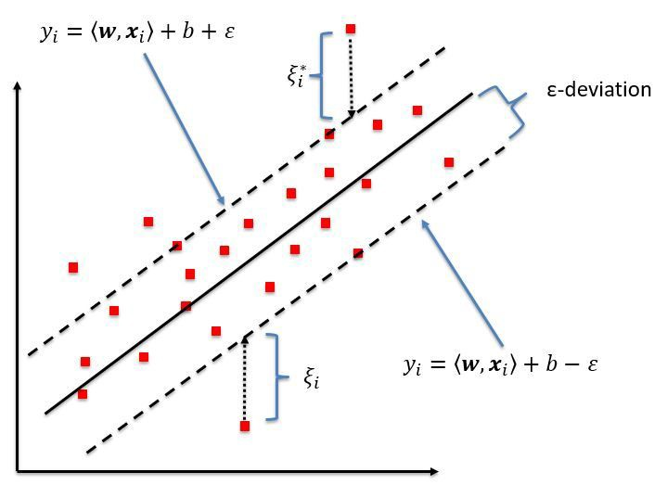
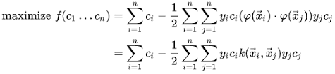
Broad Coverage – Unit 2
Support Vector Machine - Soft Margins, Multiclass, Regression and SMO

Slide 9
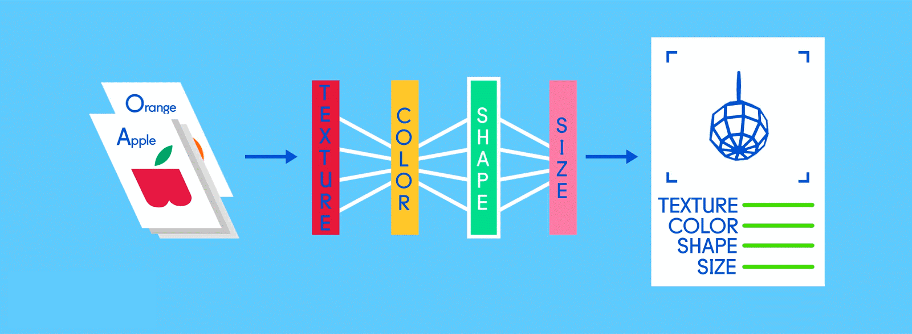

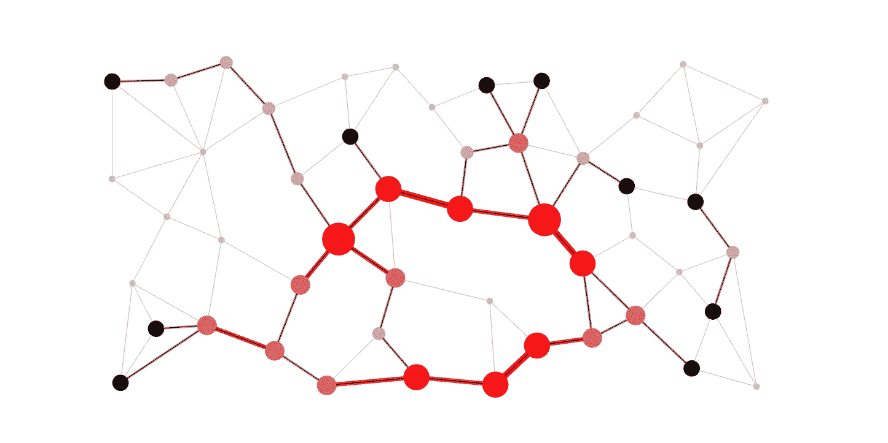
Broad Coverage - Unit 3
CNN and GNN

Slide 10
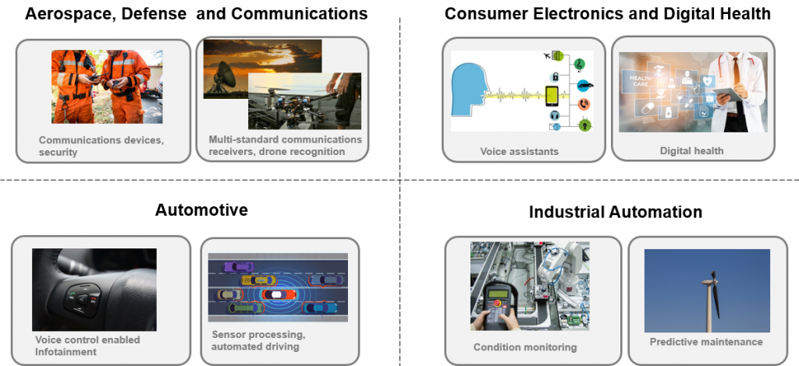
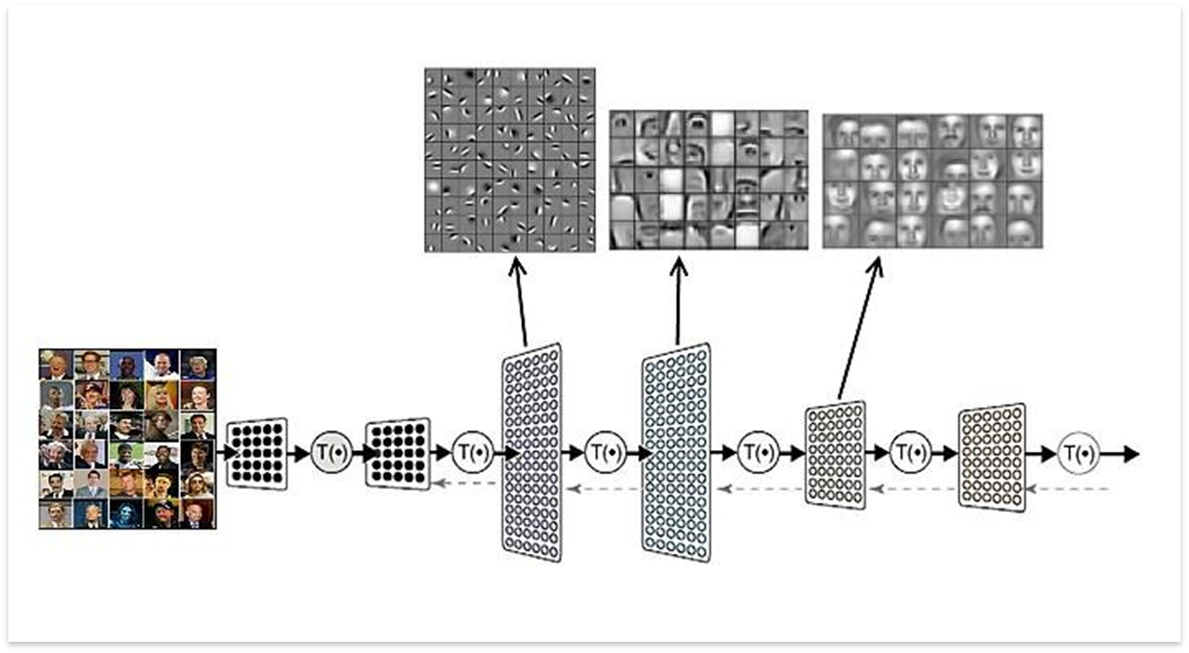
Broad Coverage - Unit 3
CNN

Slide 11


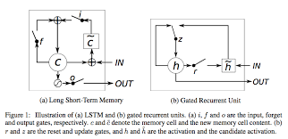
Broad Coverage – Unit 4
RNN, LSTM AND GRU

Slide 12
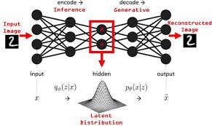
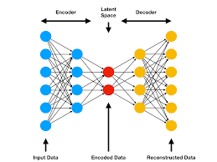
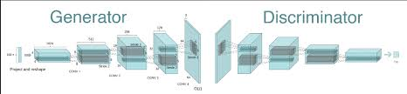
Broad Coverage – Unit 4
Auto Encoders and GANs

Slide 13

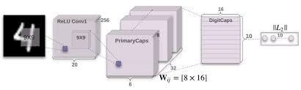
Broad Coverage – Unit 5
Research papers – Capsule networks and Transformers

Slide 14

Evaluation Criteria – To be approved
ISA 1 - 20 marks as defined by University (CBT/Pen and Paper)
ISA 2 - 15 marks as defined by University (CBT/Pen and Paper)
Quiz - 15 marks ( 5 Quizzes) - 1 per Unit 10 marks each
ESA - 35 marks
ESA Assignments – 15 Marks ( 3 Assignments ) each at 10 Marks
Quiz – In Class
Concepts, Maths and Programs - 20 Minutes
Assignments:
Implementation of CNN for a defined problem
Implementation of GAN for a defined Problem
Summarization of SOTA Research Paper/Usage of a Capsule Network/Transformer
All Assignments in Tensorflow

Slide 15
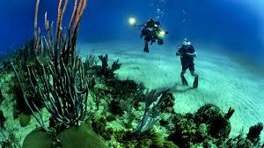



Most of What you Learn in State of the Art
Pre-Requisites
Machine Learning
Statistics
Linear Algebra
Love for diving deep and having fun

